Slide 1
Jean Nicolet
Who Was He, Really?
Notes:
Educator notes: Each slide has specific areas (correct answers) to click on to advance the story. Please take a few minutes to familiarize yourself with this work before presenting it to your class.

Slide 2
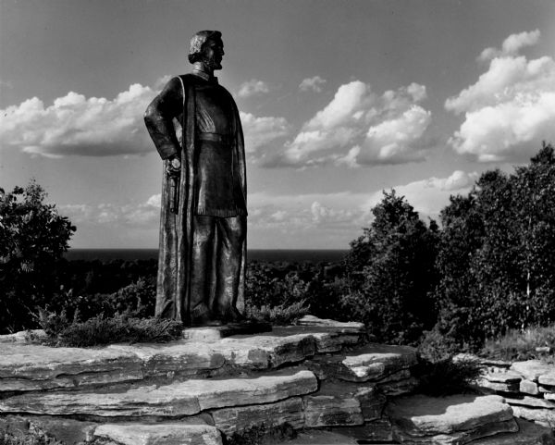
What do you know about Jean Nicolet?
Jean Nicolet was…
An explorer hired by Spain to find new lands to conquer.
An explorer from New France looking for the Northwest Passage.
An interpreter and diplomat hired to begin official relations with Native nations.
None of the above.
Notes:
WHS image 39915; Correct answer: Interpreter and Diplomat

Slide 3
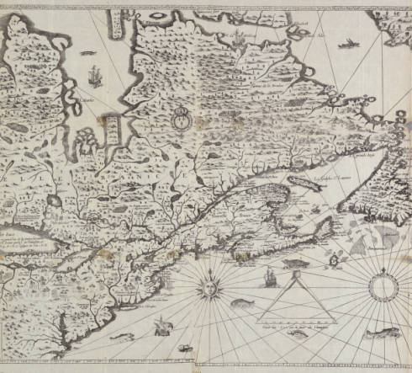
You are Jean Nicolet and you work for the Governor of New France, Samuel de Champlain.
Notes:
WHS images 69488; 27032 What do you notice about this statue of Samuel de Champlain? (Conquistador, crouching Native Americans) Ask: What do you think about this monument? Who might be upset by it? Why is it built this way?

Slide 4
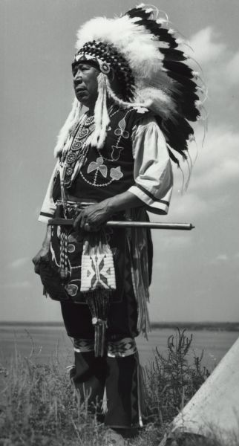
As an interpreter for New France, you have lived among the Nippising, a Native nation of the St. Lawrence River Valley. You also have acted as an ambassador between nations.
What does an ambassador do?
Makes laws for colonies.
Write histories of other times and places.
Officially represent a nation’s interests.
Lead troops into battle.
Notes:
Chief Albert Yellow Thunder, Sr. (Ho-Chunk, whose ancestors were the Puans) WHS image 126046. Correct answer: Represent a nation

Slide 5
New France existed in what we now call Canada. In 1634, Quebec was the largest French settlement in New France. It was still very small. Less than 300 European colonists lived there.
Quebec
Notes:
Classroom clipart; “Misunderstood Adventures of Jean Nicolet”

Slide 6
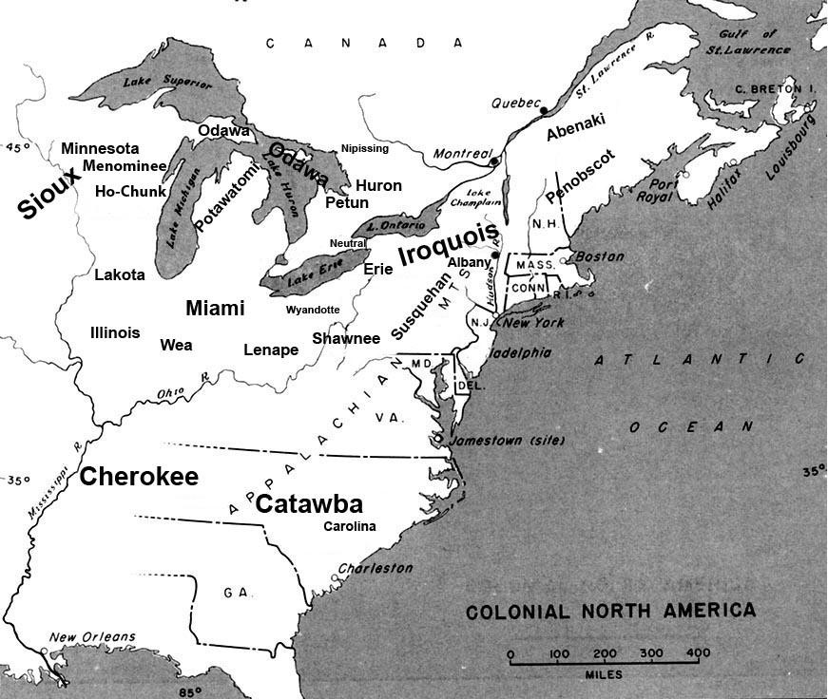
Governor Champlain worried about his small colony. Since arriving, New France had made friends…and enemies. The Five Nations League of Iroquois was one such powerful enemy. To survive, New France would need powerful allies. One way New France gained allies was through trade. The Huron and Ottawa (Odawa) Indian nations were allies of New France.
Notes:
“Misunderstood Adventures of Jean Nicolet” image

Slide 7
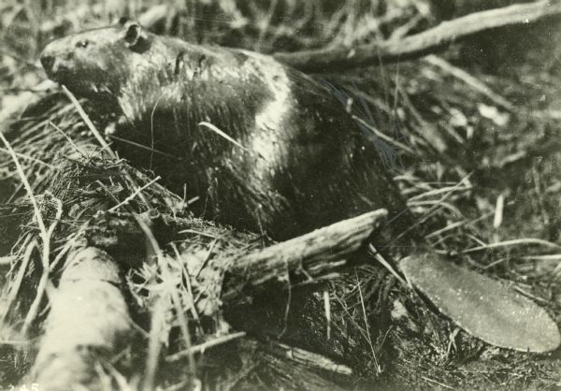
What kind of riches did the people of New France trade for with Native Americans?
Gold, silver, and other precious metals.
Furs, timber, and seafood.
Diamonds, rubies, and other gems.
None of the above.
Notes:
WHS images 79185; correct answer: Furs, Timber

Slide 8
“Jean,” says Governor Champlain, “I have a very important mission for you. Your skill with languages and friendships with Native Americans will come in very handy…”
Governor Champlain wants you to find a northern sea route to China called the Northwest Passage, if it exists.
Governor Champlain wants you to meet with Native nations and use your diplomatic skills to make peace between our allies and the Ho-Chunk.
Governor Champlain wants you to establish a French colony in the Great Lakes region.
All of the above.
Notes:
Correct answer meet with Native nations

Slide 9
Governor Champlain waits for your questions…
Where exactly do you want me to go?
Who are the people you want me to meet?
What do you want me to do when I get there?
What should I pack for the journey?
That’s all the questions I have.
Notes:
Ask students what questions they might have before showing the choices.

Slide 10
“I want you to go to this region. I have reason to believe we could make powerful allies there.”
I have more questions…
Notes:
WHS images

Slide 11
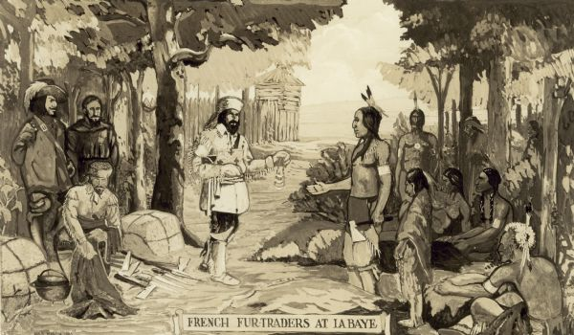
“The people are called the Ho-Chunk. Their allies are the Menominee. I’ve heard they are very powerful! New France needs allies against the Iroquois Confederacy.”
I have more questions…
Notes:
WHS image 60960

Slide 12
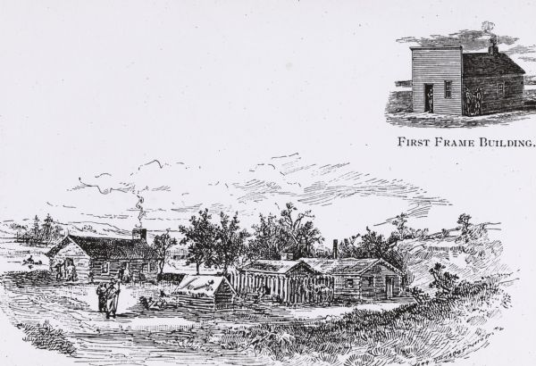
“When you arrive, show the people that the French are powerful. But remember, we want peace and trade.”
I have more questions…
Notes:
WHS images 4714

Slide 13
“What you pack is up to you. Be sure it will help you in your mission”
Tools for building, pistols, medicines, and animal trapping materials.
A Chinese silk robe, Mandarin style hat, and a book on the Mandarin language.
Tough clothes, pistols, gifts for the Natives, and a silk cape for formal occasions.
Seeds for starting crops, tools for building, and medicines.
I have more questions…
Notes:
Painting by Frances Anne Hopkins; correct answer: Tough clothes, pistols, etc.

Slide 14
You pack for your journey…
Unfortunately, the things you packed did you little good. You’ll have to go back and re-pack for your mission.
Go back and re-pack.

Slide 15
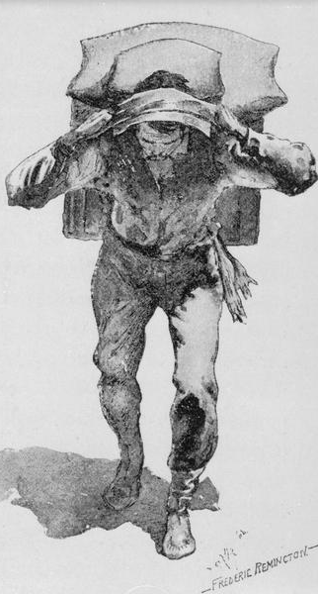
You will need a tough and experienced crew for your journey. Who do you bring?
You continue your journey…
Some farmers, a blacksmith, and a land surveyor from New France.
Native American allies who know the land and water routes through the Great Lakes.
A nobleman, a priest, and other missionaries from New France.
A composer, a poet, and an artist from France.
I have more questions…
Notes:
WHS 30348; correct answer: Native American allies

Slide 16
You choose the members of your party…
The people you brought along have no idea what to do. You’ll have to go back and choose some different members for your crew.
Go back and re-choose.

Slide 17
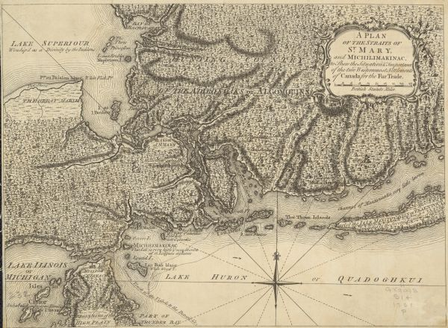
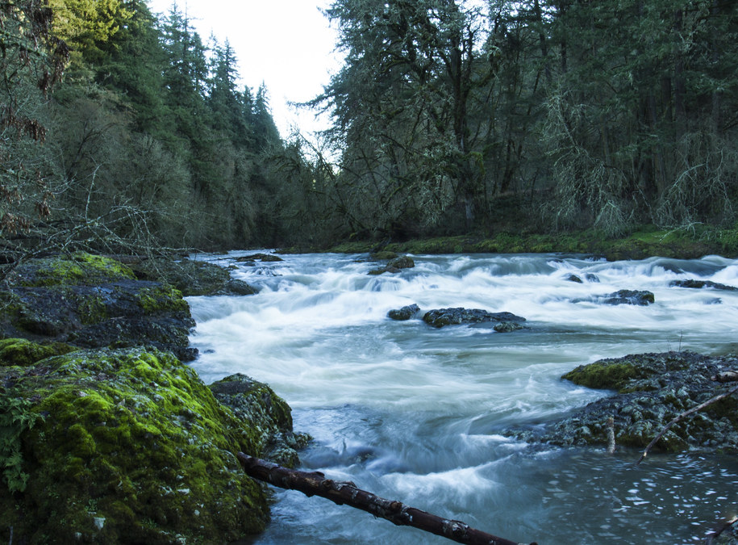
You have a decision to make…
You continue your journey…
You are here
Head west by northwest. Your guides tell you there are great rapids ahead, but in three days journey you will come to a great sea. Today that sea is known as Lake Superior.
Head west by southwest. Your guides tell you that you will continue paddling for many days until you reach another great sea. Today that sea is known as Lake Michigan.
Notes:
Image Public Domain via Creative Commons; Correct answer: Lake Michigan

Slide 18
You head west by northwest…
With some difficulty you manage to portage and paddle your way through the Sault Ste. Marie rapids. In three days you arrive at Lake Superior.
Unfortunately, the Puans are nowhere to be found.
Go back and head west by southwest.

Slide 19
You travel for many days. Your party is getting nervous. Why?
You continue your journey…
Your guides don’t like traveling far from home.
You were running out of food and water. You’d never make it to Asia with what you have left!
Your guides had no idea where they were and wanted to turn back.
The Hurons and Ottawa Indians with you are at war with the Ho-Chunk and their allies.
Notes:
MENOMINEE WAR DANCE WHS Image 91267; correct answer: Hurons and Ottawa are at war.

Slide 20
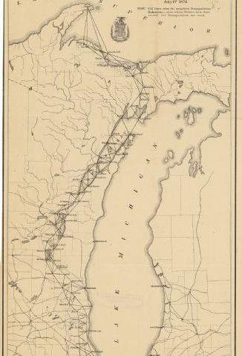
You are on the northern edge of Lake Michigan near the entry to Green Bay. Where do you go from here?
You continue your journey…
You paddle your canoes directly to the Ho-Chunk, landing ashore and announcing your arrival with your pistols. You will make them become your allies!
You are here.
Menominee
Ho-Chunk
You decide to head a bit north and leave your canoes behind. You travel by land along the shore, hoping to find allies along the way.
Notes:
Map WHS image 116547; Correct answer: Head north and leave canoes

Slide 21
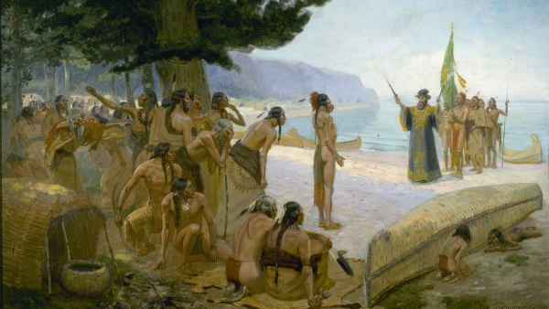
You head directly to the Ho-Chunk nation…
When you arrive, your land your canoe ashore and fire your pistols into the air in a show of French power! Suddenly arrows and spears rain down from the sky. The entire Ho-Chunk nation is after you! You and your guides beat a hasty retreat, barely escaping with your lives!
Go back and choose again.
Notes:
WHS image 1870

Slide 22
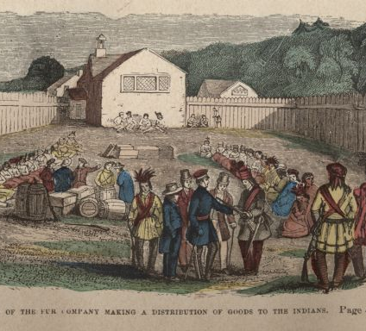
You are in hostile territory. What do you do?
You continue your journey…
Prepare for battle. Send one of your men to threaten the nearest village.
Leave a peace offering on shore. Send one of your men to the nearest village to talk about trade.
Notes:
WHS images 118311; correct answer: Peace offering

Slide 23
You prepare for battle…
But you realize that you are outnumbered 1000 to 1. You decide against it.
Go back and choose again.

Slide 24
Your peace offering is accepted! The Menominee generously agree to arrange a council meeting and feast for you. What do you do?
You continue your journey…
Menominee
You refuse, stating that your message is for the Ho-Chunk alone.
You accept. You feel that the Grand Village of the Menominee is a good place to talk with both nations.
Notes:
WHS images; Correct answer: Grand village

Slide 25
You refuse to meet with the council.
You are reminded that the Ho-Chunk will be there as well, and that makes your mind up to go.
Go back and choose again.

Slide 26
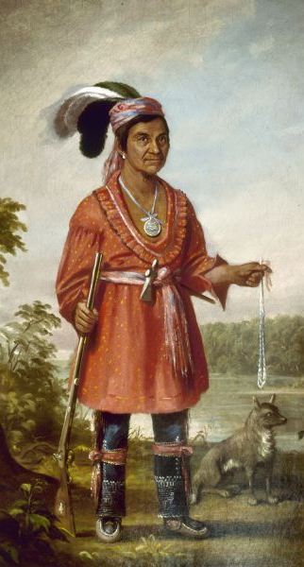
What do you wear for the feast?
You continue your journey…
A Chinese silk robe, a Mandarin-style hat, and a belt.
The same smelly clothes you’ve been traveling in.
A fancy silk cape and your best clothes.
A coon-skin cap and a leather jacket with lots of fringes.
Notes:
John Quinney, Stockbridge Indian in finery. WHS 1923. Correct answer: best clothes. You want the Puans and Menominee to know you respect them!

Slide 27
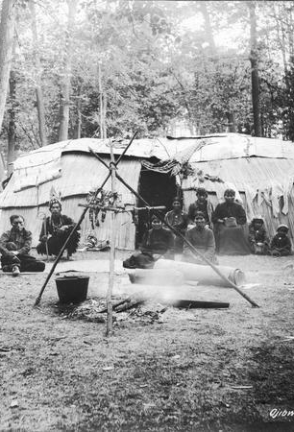
You arrive! Women and children surround your group. There are thousands of men, women, and children. What do you do?
You fire your pistols into the air in a show of French power! Then you hand out presents to show you are friendly.
You start by handing out gifts. When they are all gone, eat and leave.
You arrange for musicians to play music as you arrive.
None of the above.
Notes:
WHS images 6912 Correct answer: Fire pistols

Slide 28
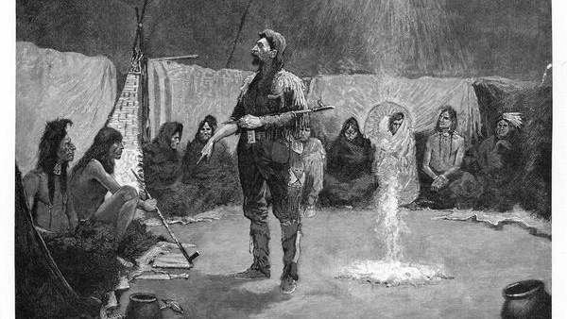
SUCCESS! You negotiate a peace treaty with the Ho-Chunk and Menominee nations!
Notes:
WHS images 3775

Slide 29
What did we learn about Jean Nicolet?
He was not lost
He was not an explorer
He did not wear Chinese robes
He did not land a canoe at Red Banks firing his weapons
He was a skilled diplomat who spoke many languages
He knew that he needed to keep the peace to be successful
He wore his best clothes for an important feast, even a silk cape
He landed somewhere north of Green Bay and traveled on foot
He entered modern-day Wisconsin near Marinette, not Red Banks
He fired his guns into the air and gave presents away at a great feast
He made peace with the Menominee and Ho-Chunk nations

Slide 30
Please visit wisconsinhistory.org/learn for more exciting educational opportunities!
Questions? Contact: education@wisconsinhistory.org

